Slide 1



BANGALORE TECHNOLOGICAL INSTITUTE Department of Computer Science & Engineering
Store Management System
Presented By:-
Amrit Tulsyan(1BH20CS004)
Chandan Gowda(1BH20CS012)

Slide 2
Introduction:-
BANGALORE TECHNOLOGICAL INSTITUTE Department of Computer Science & Engineering
The Main aim of Store management Mini DBMS project are:-
To keep track of seller
To keep track of customer
To keep track of purchased items
To keep track of sale of item
The project starts by creating a seller, then a customer, purchase some products from seller (dealer) and note the changes to inventory, The purchased goods can be modified later which demonstrates the update functionality of project. Finally we can record a sale and note the changes to product quantity in inventory page.

Slide 3
Software & Hardware Requirements:-
BANGALORE TECHNOLOGICAL INSTITUTE Department of Computer Science & Engineering
Operating system : Windows XP/7/10.
Coding Language : FLASK/HTML/CSS/JavaScript
Tool : VS Code/XAMPP
Database : MYSQL
Frontend: HTML/CSS
Backend: FLASK

Slide 4
Existing system
BANGALORE TECHNOLOGICAL INSTITUTE Department of Computer Science & Engineering
Most commonly used method to keep updates of store is Hand written books

Slide 5
Problems in existing system
BANGALORE TECHNOLOGICAL INSTITUTE Department of Computer Science & Engineering
Non-lasting Records
Unclear Communication
Inadequate Access
Inefficient Warehouse Management
Overselling
Spoiled Goods

Slide 6
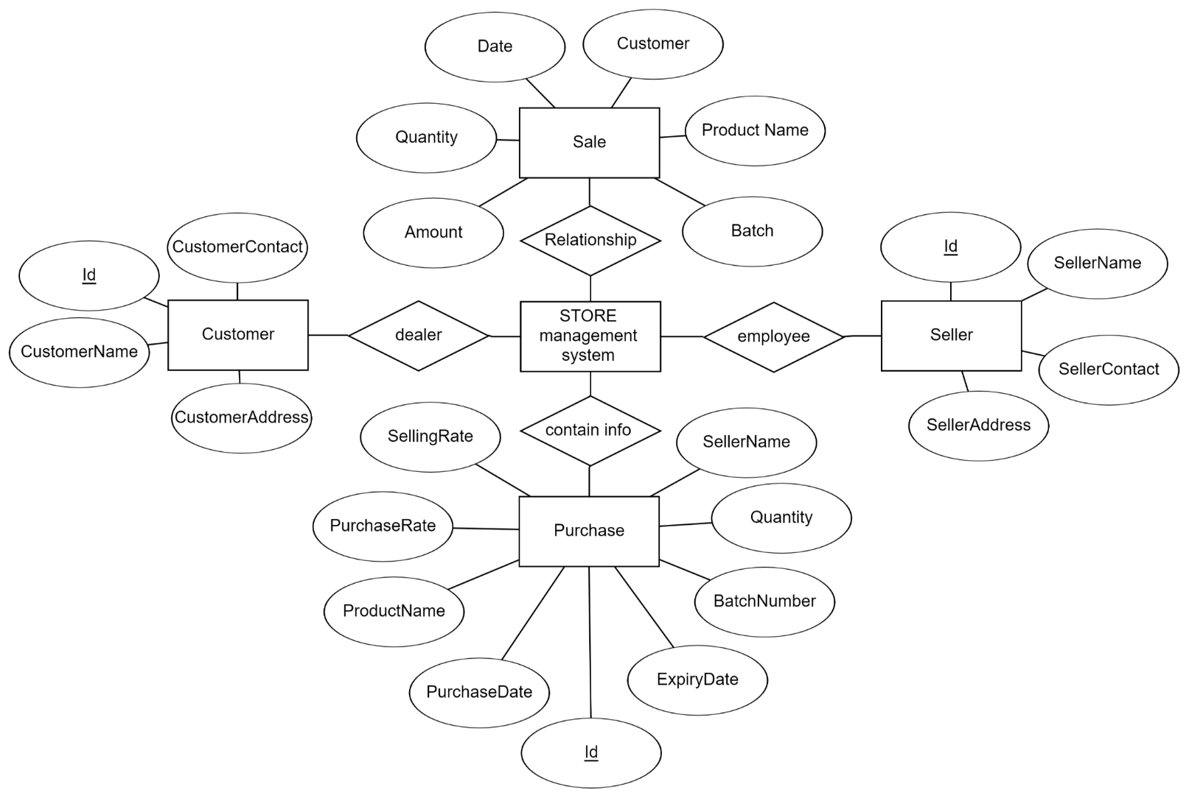
ER Diagram:-
BANGALORE TECHNOLOGICAL INSTITUTE Department of Computer Science & Engineering

Slide 7
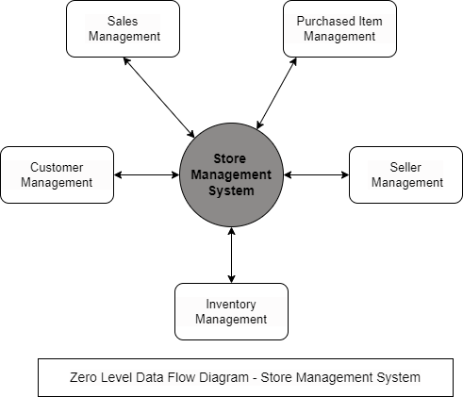
Data Flow Diagram:-
BANGALORE TECHNOLOGICAL INSTITUTE Department of Computer Science & Engineering

Slide 8
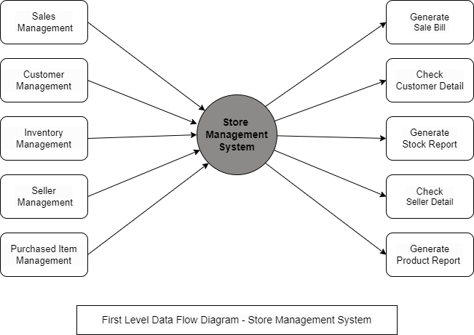
BANGALORE TECHNOLOGICAL INSTITUTE Department of Computer Science & Engineering

Slide 9
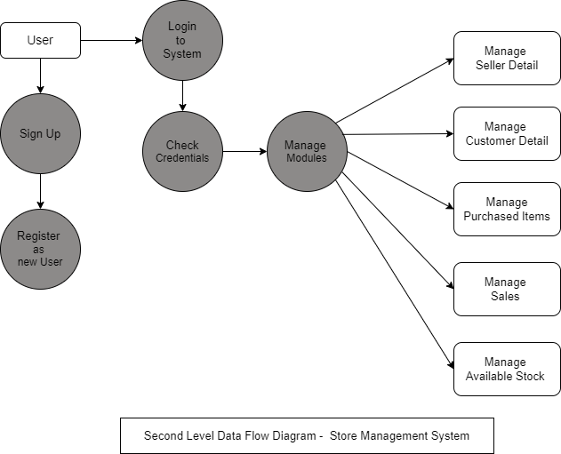
BANGALORE TECHNOLOGICAL INSTITUTE Department of Computer Science & Engineering

Slide 10
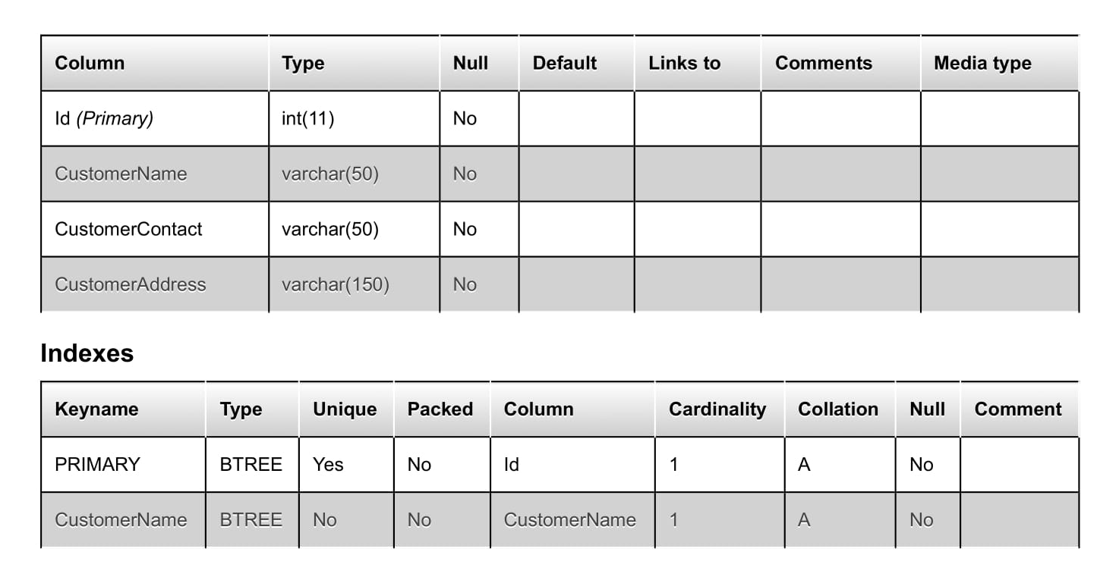
Data Dictionary:-
BANGALORE TECHNOLOGICAL INSTITUTE Department of Computer Science & Engineering
Customer Table:-

Slide 11
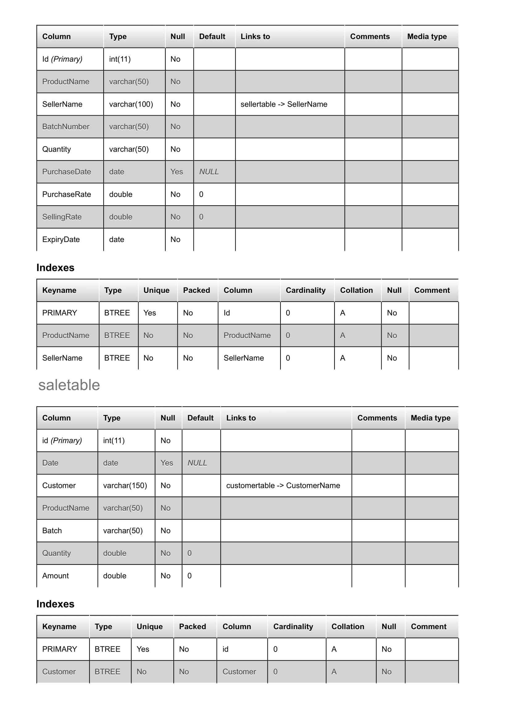
BANGALORE TECHNOLOGICAL INSTITUTE Department of Computer Science & Engineering
Purchase Table:-

Slide 12
BANGALORE TECHNOLOGICAL INSTITUTE Department of Computer Science & Engineering
Sale Table:-

Slide 13
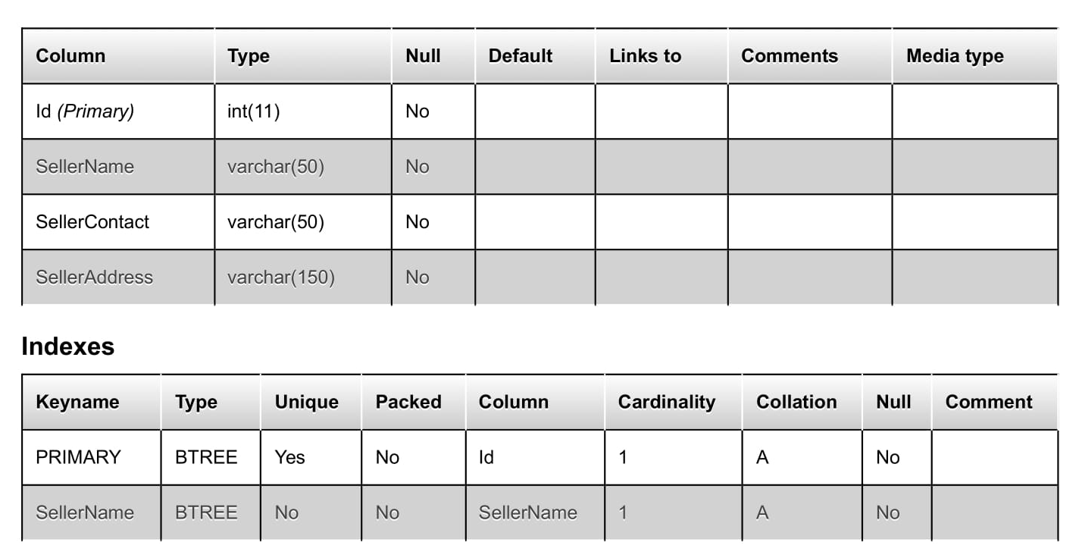
BANGALORE TECHNOLOGICAL INSTITUTE Department of Computer Science & Engineering
Seller Table:-

Slide 14
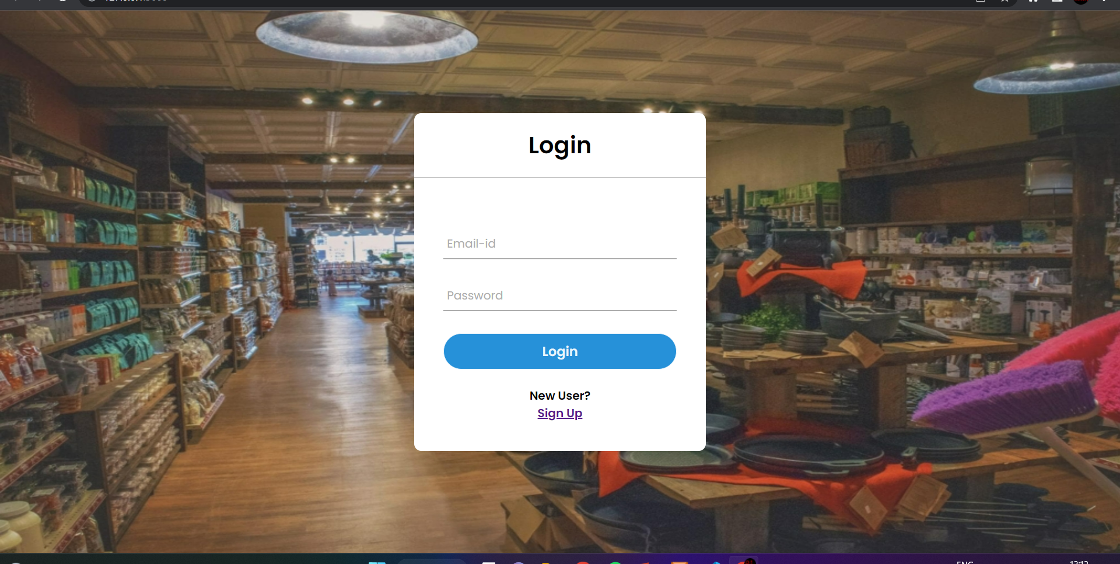
Screen Layouts:-
BANGALORE TECHNOLOGICAL INSTITUTE Department of Computer Science & Engineering
Login Page:-

Slide 15
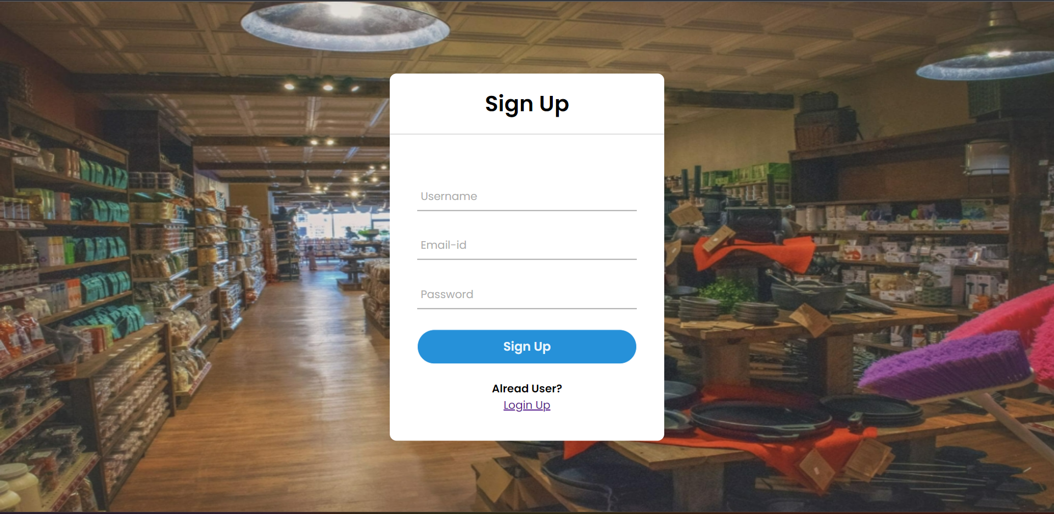
BANGALORE TECHNOLOGICAL INSTITUTE Department of Computer Science & Engineering
Sign Up Page:-

Slide 16
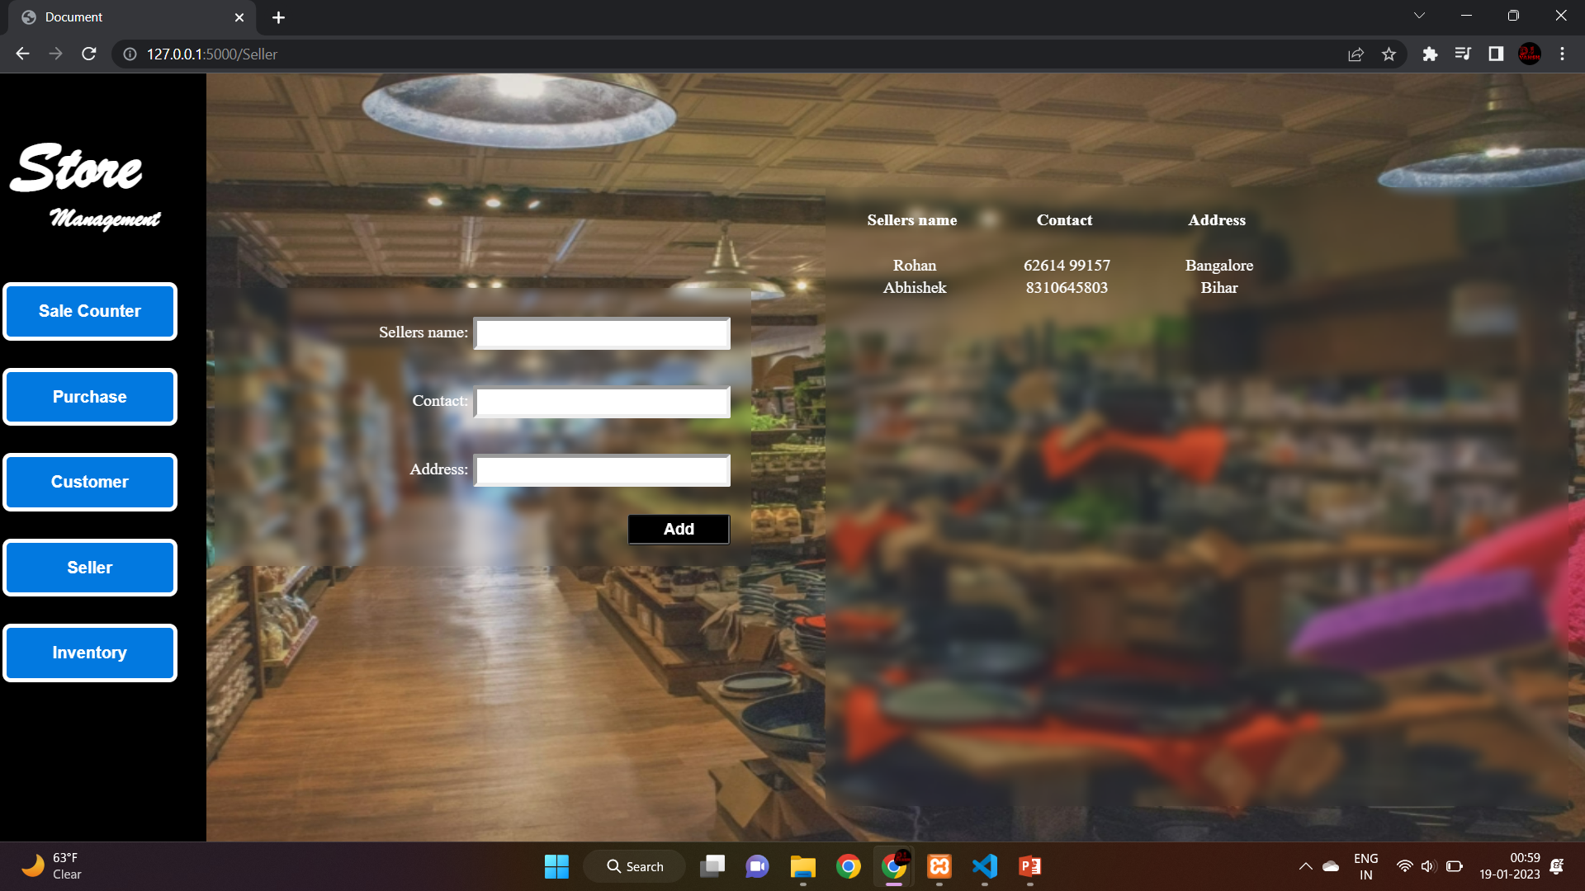
BANGALORE TECHNOLOGICAL INSTITUTE Department of Computer Science & Engineering
Seller Page:-

Slide 17

BANGALORE TECHNOLOGICAL INSTITUTE Department of Computer Science & Engineering
Customer Page:-

Slide 18
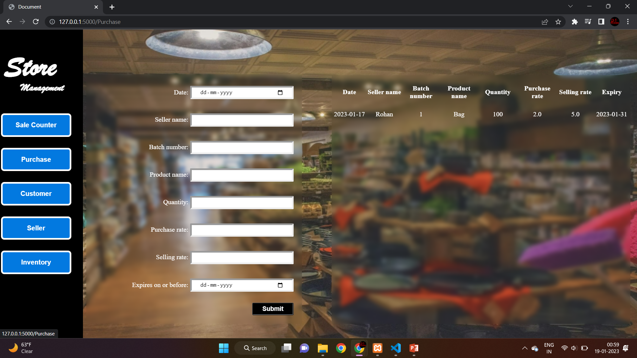
BANGALORE TECHNOLOGICAL INSTITUTE Department of Computer Science & Engineering
Product Page:-

Slide 19
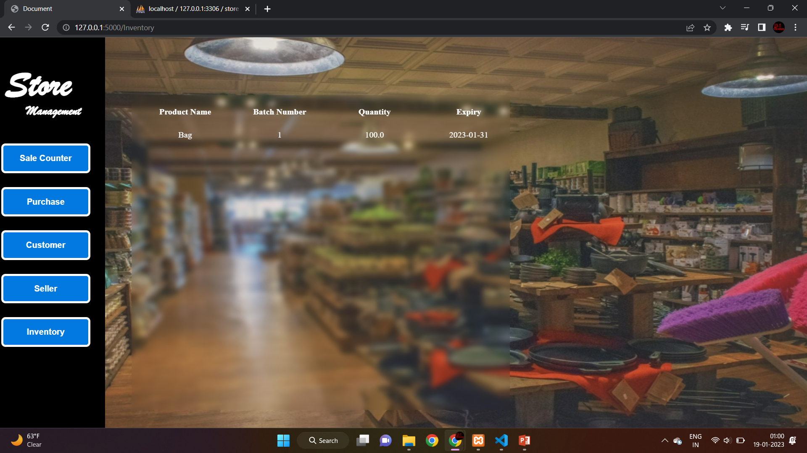
BANGALORE TECHNOLOGICAL INSTITUTE Department of Computer Science & Engineering
Inventory Page:-

Slide 20
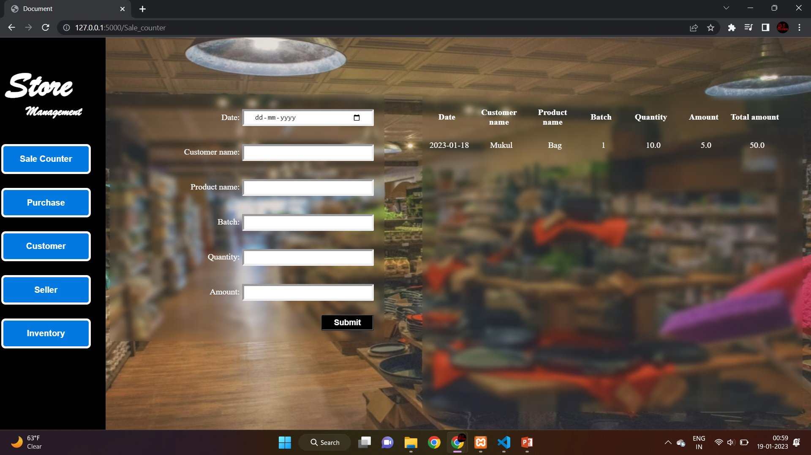
BANGALORE TECHNOLOGICAL INSTITUTE Department of Computer Science & Engineering
Sale Page:-

Slide 21
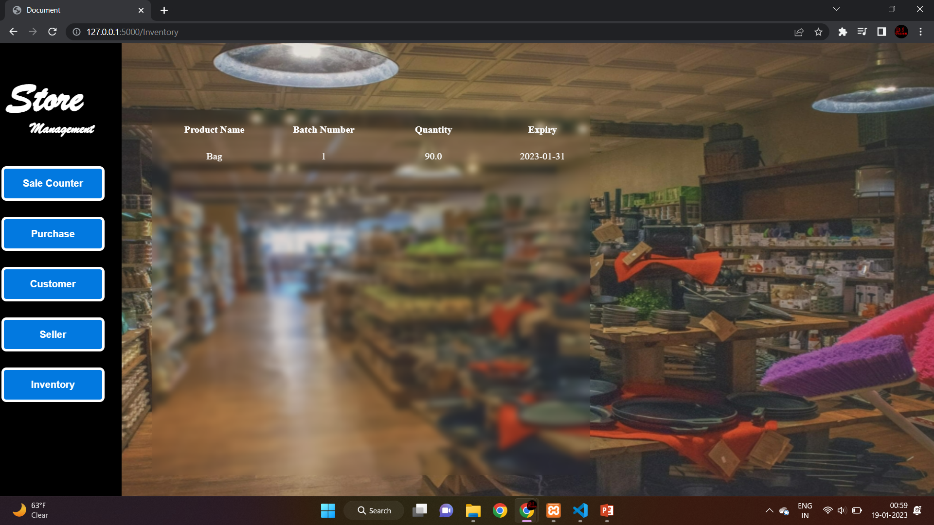
BANGALORE TECHNOLOGICAL INSTITUTE Department of Computer Science & Engineering
Inventory Page:-

Slide 22

Conclusion:-
BANGALORE TECHNOLOGICAL INSTITUTE Department of Computer Science & Engineering
The purpose of this project is to overcome the written sale books.
Our Project, "Store Management System" is an idea that will uplift the power concept of inventory management, invoice generation, customer management, and seller management. Our web app can do a lot of benefits to everyone who will use it.
to conclude that the Store Management System can lead to an error-free, secure, reliable, and fast management system with a user-friendly interface.

